Slide 1

365 Super Mart's Analysis
Zohair Raza - DATA ANALYST

Slide 2
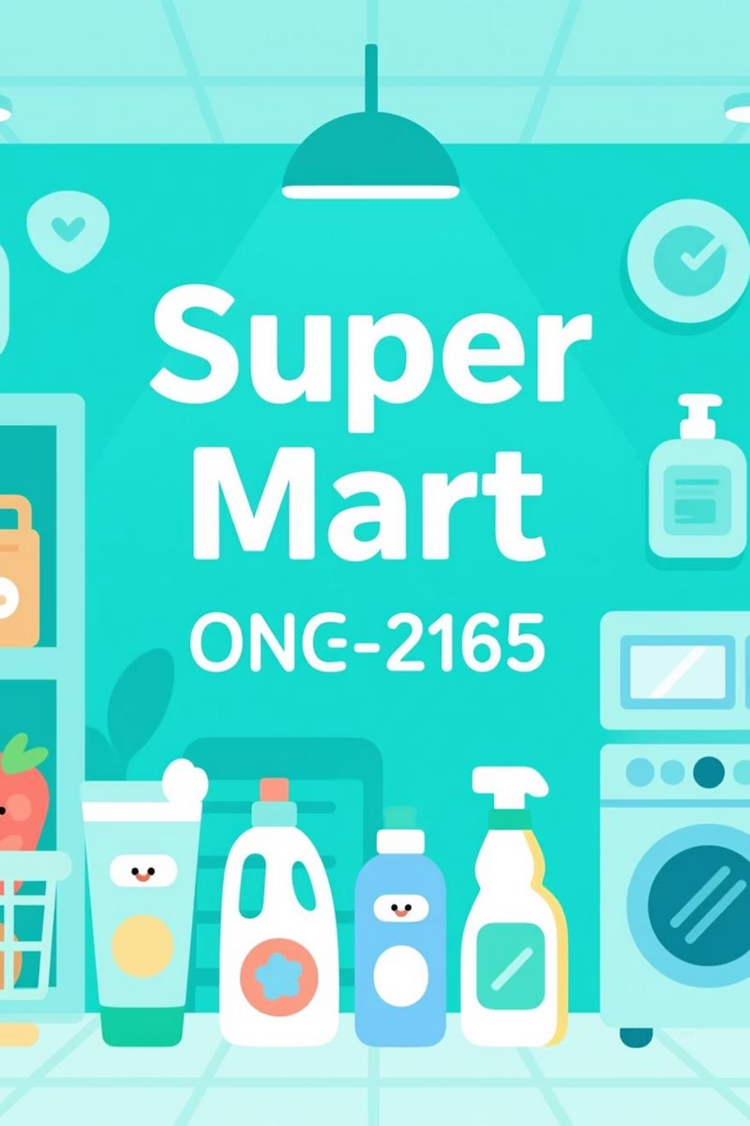
Project Insights: 365 Super Mart's Promotional Campaign Analysis
Introduction
Company: 365 Super Mart is a prominent FMCG company with a wide network of stores across several cities. It sells a variety of products, including groceries, home care, and home appliances.
Objective: The goal of this analysis is to determine the effectiveness of promotional campaigns.
Methodology: I used SQL(MySQL) to analyze a company dataset and answer key business questions.

Slide 3

Analytical Focus Areas:
Store Performance Analysis
Promotion Type Analysis
Product and Category Analysis

Slide 4
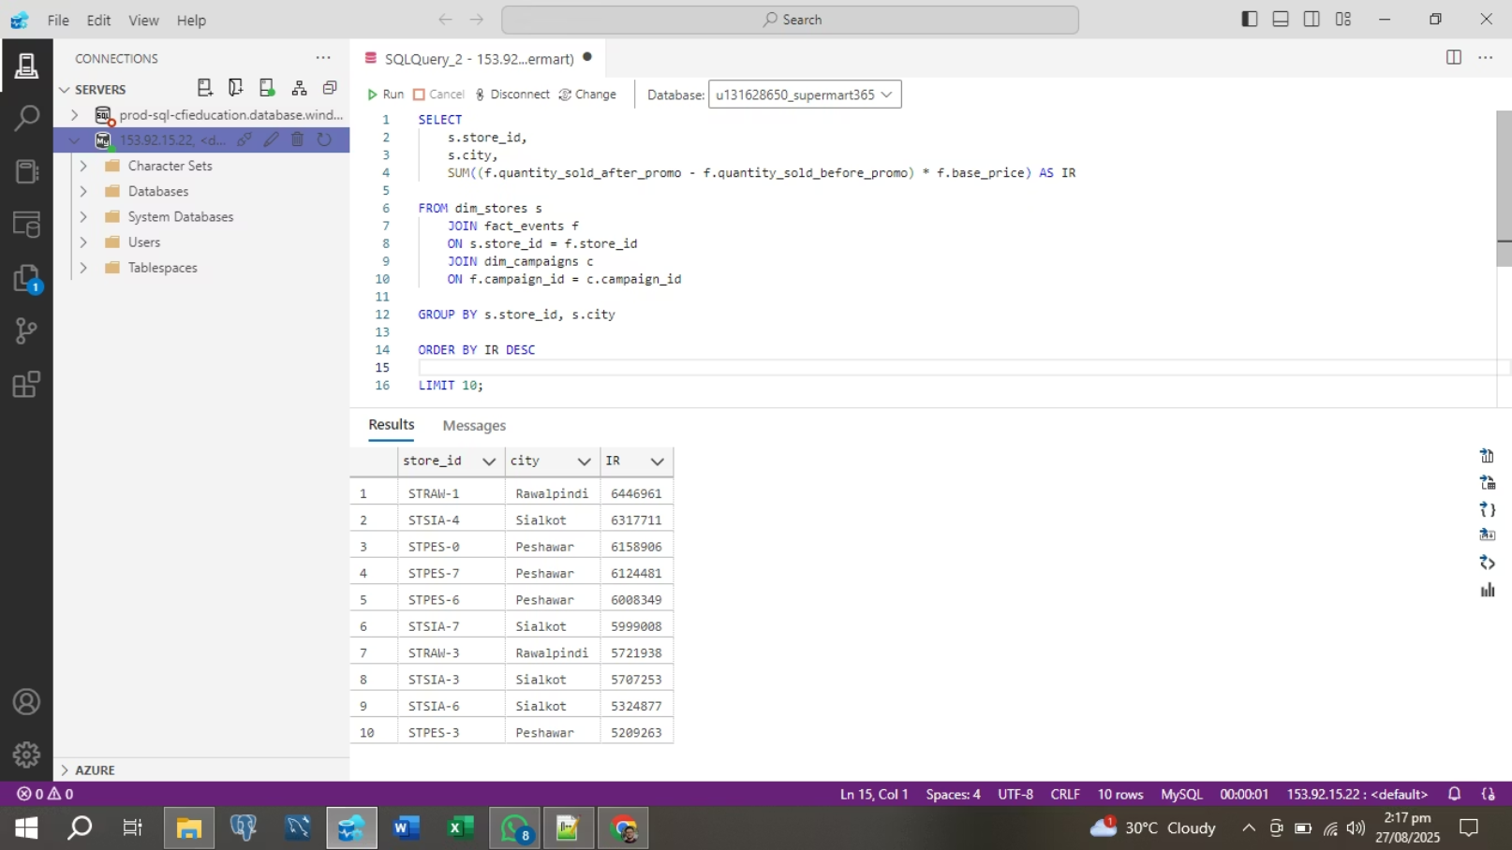
Observation 1.1: Top Performing Stores (by Incremental Revenue)
The query identified the top 10 stores based on Incremental Revenue (IR), which is the revenue generated directly from promotional sales.
STKA1 in Rawalpindi and STSA4 in Sialkot were the top performers, indicating that stores in these two cities are highly responsive to promotions. These locations should be a focus for future high-value campaigns.

Slide 5
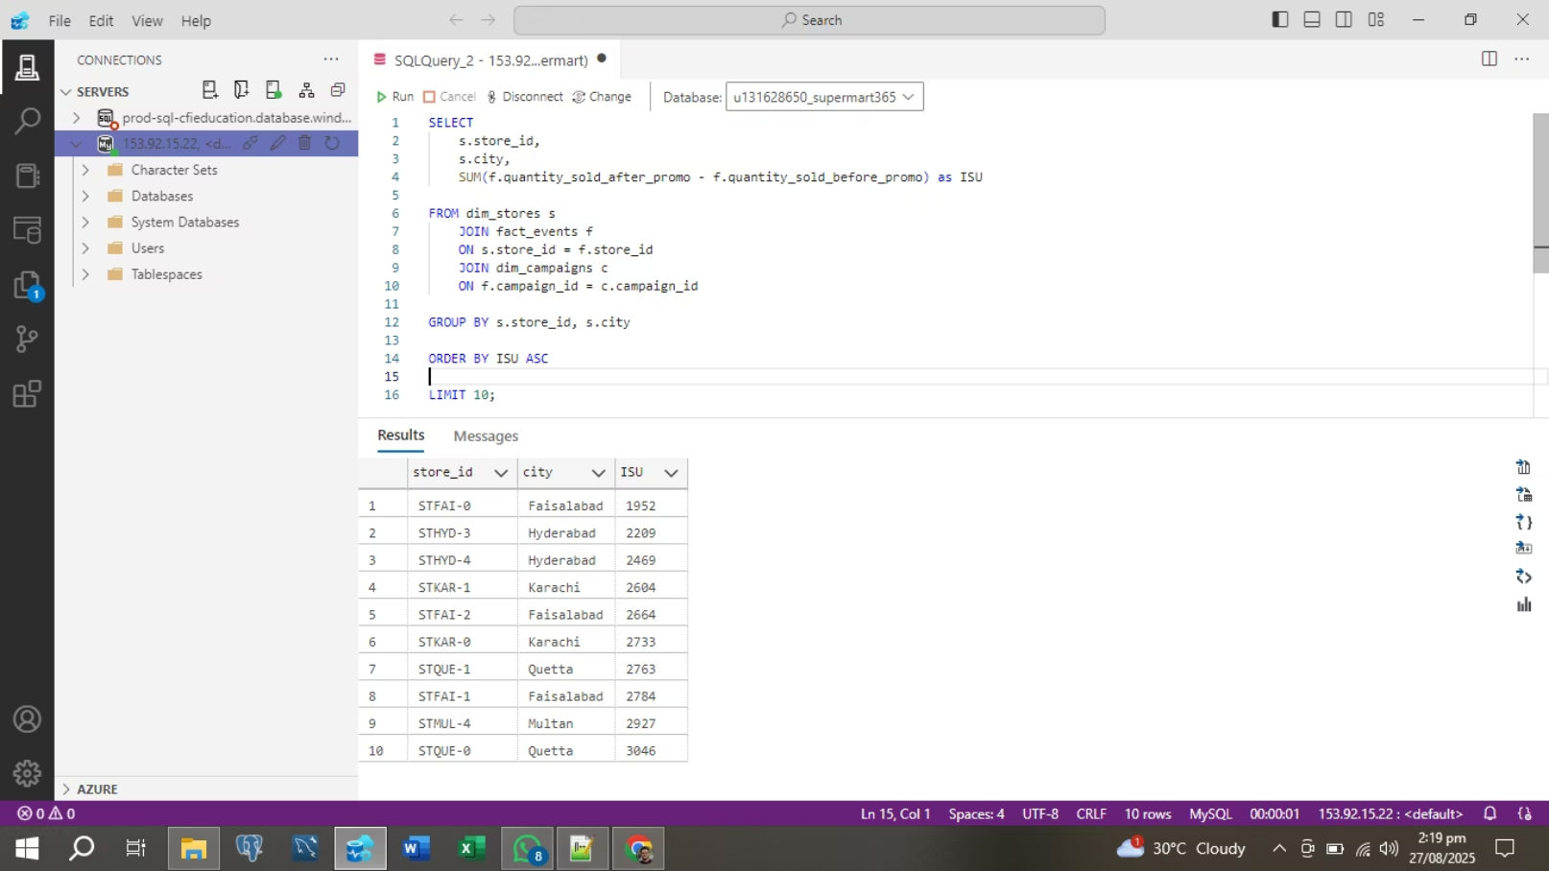
Observation 1.2: Bottom Performing Stores (by Incremental Sold Units)
This query highlighted the bottom 10 stores based on Incremental Sold Units (ISU), revealing where promotions had the least impact on the volume of products sold.
Stores in Faisalabad and Hyderabad were among the lowest performers. This suggests that the current promotional strategies may not be effectively reaching or enticing customers in these areas.

Slide 6
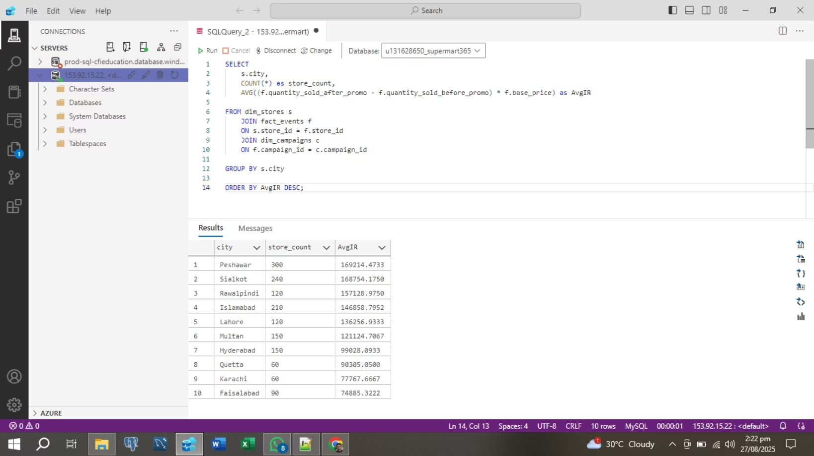
Observation 1.3: Store Performance by City (Average Incremental Revenue)
This analysis explored store performance at a city level by calculating the average incremental revenue per store.
Peshawar and Sialkot had the highest average incremental revenue per store.
The data shows a correlation between a city's number of stores and its overall promotional impact. For example, Peshawar, with 300 stores, contributed significantly to overall revenue from campaigns. In contrast, cities with fewer stores, like Karachi and Faisalabad, showed lower average revenue, suggesting that a one-size-fits-all approach to promotions might not be optimal.

Slide 7
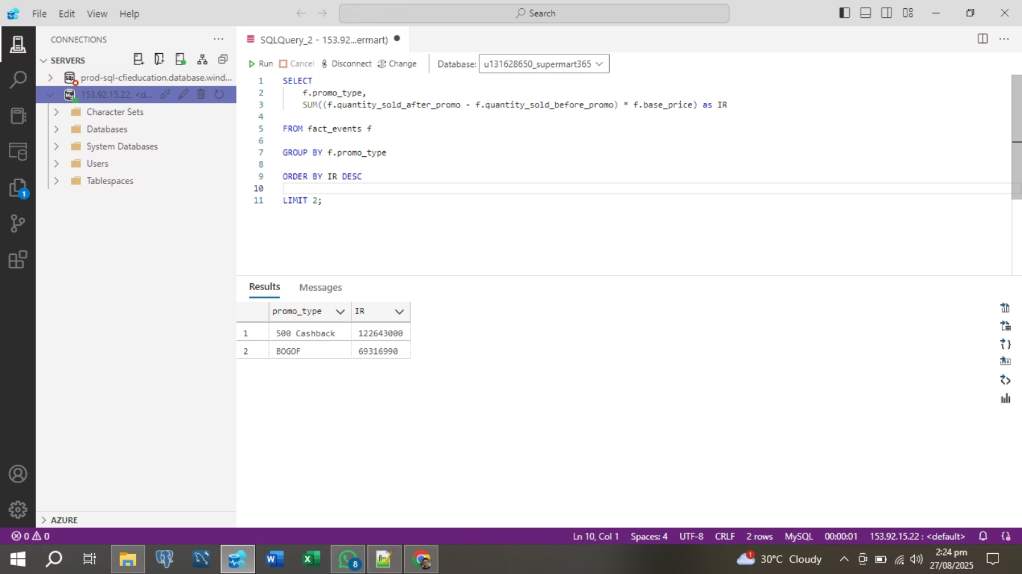
Observation 2.1: Highest Incremental Revenue by Promotion Type
This query determined which two promotion types generated the most Incremental Revenue (IR).
500 Cashback and BOGOF (Buy One Get One Free) were the most successful promotion types for generating revenue. These promotions not only drive a high volume of sales but also appear to be well-received by customers, leading to a strong return on investment.

Slide 8

Observation 2.2: Lowest Incremental Sold Units by Promotion Type
This query focused on which promotion types resulted in the least amount of Incremental Sold Units (ISU).
25% OFF and 50% OFF promotions led to the lowest increase in units sold. The 25% OFF promotion even showed a negative value, which could mean it failed to attract new sales and instead just lowered the price for customers who would have bought the product anyway, a phenomenon known as sales cannibalization.

Slide 9
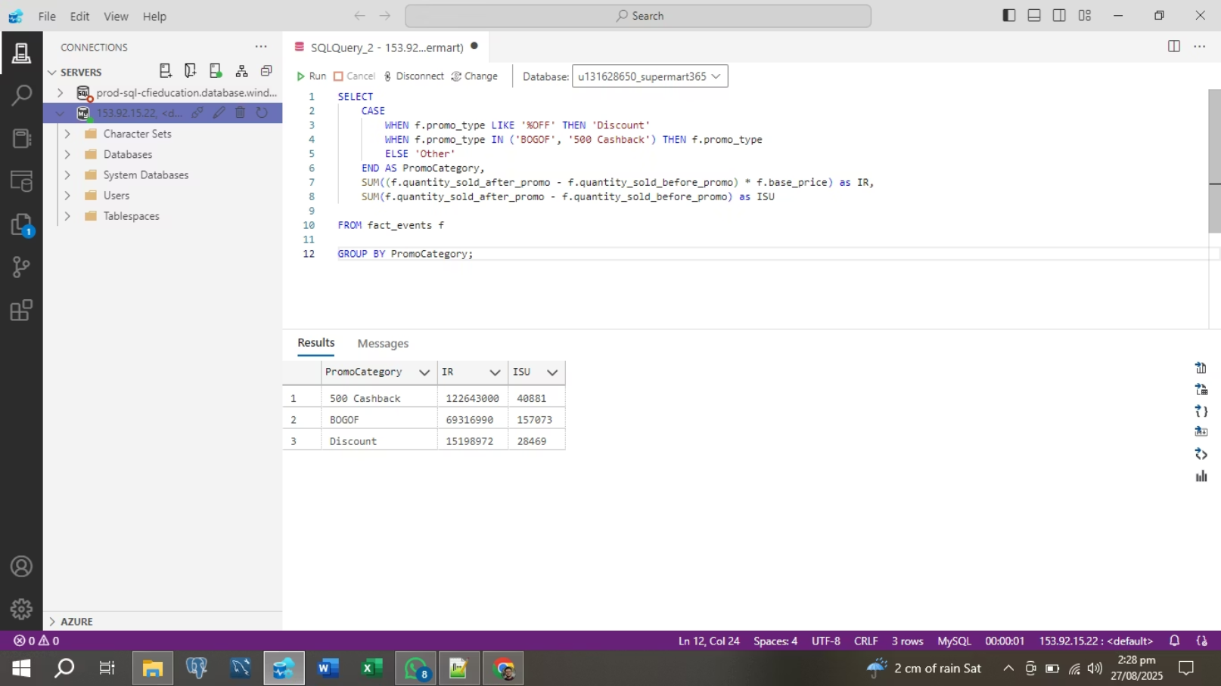
Observation 2.3: Comparing Promotion Effectiveness
This analysis provided a broader comparison of different promotion types based on both revenue and sold units.
BOGOF and 500 Cashback were the clear top performers across both metrics, confirming their effectiveness. In comparison, general "Discount" promotions showed positive revenue but a much lower impact on the number of units sold, reinforcing the idea that they are less effective at driving sales volume.

Slide 10

Observation 2.4: Profit Margin vs. Sold Units
This query examined the balance between units sold and profit margins for different promotion types.
BOGOF and 500 Cashback demonstrated an optimal balance, driving a high volume of sales while maintaining healthy profit margins. This is in stark contrast to percentage discounts, which had a low impact on sales units and resulted in a lower overall profit margin.

Slide 11

Observation 3.1: Top Performing Categories (by Sales Lift)
This query identified which product categories saw the biggest Sales Lift during promotional campaigns.
Grocery & Staples experienced the most significant sales lift, with Combol and Home Appliances also showing strong performance. This indicates that consumers are most likely to increase their purchases of these items when they are on promotion.

Slide 12
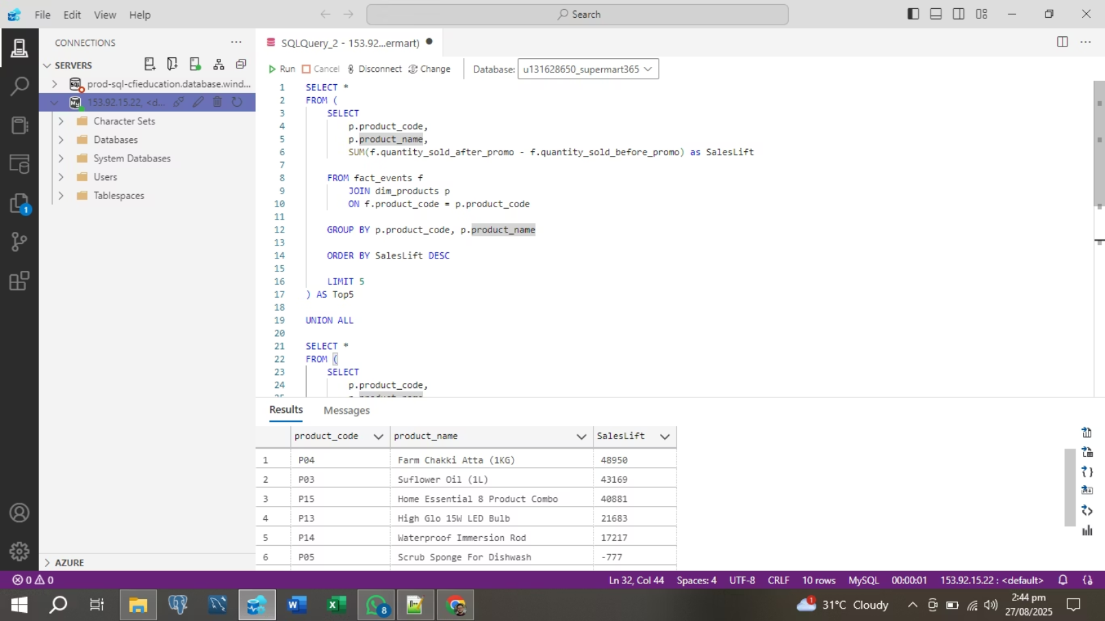
Observation 3.2: Top Performing Products (by Sales Lift)
This query pinpointed specific products that performed exceptionally well (or poorly) in response to promotions.
Farm Chakki Atta and Sunflower Oil, both staples in the Grocery & Staples category, were the top-performing products. However, the Scrub Sponge for Dishwash showed a negative sales lift, indicating the promotion was ineffective for this product.

Slide 13
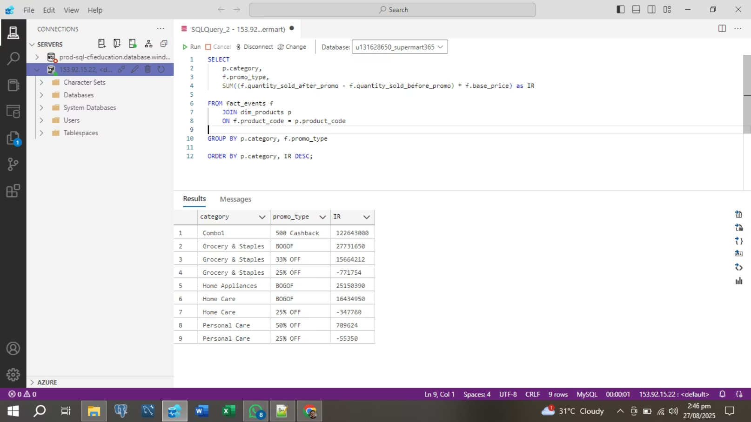
Observation 3.3: Category and Promotion Effectiveness
This final analysis explored the relationship between product categories and the success of various promotion types.
The findings revealed that Grocery & Staples performed exceptionally well with 500 Cashback and BOGOF promotions. Home Appliances and Home Care also showed strong results with BOGOF. This highlights the importance of tailoring promotion types to specific product categories to maximize their effectiveness.

Slide 14
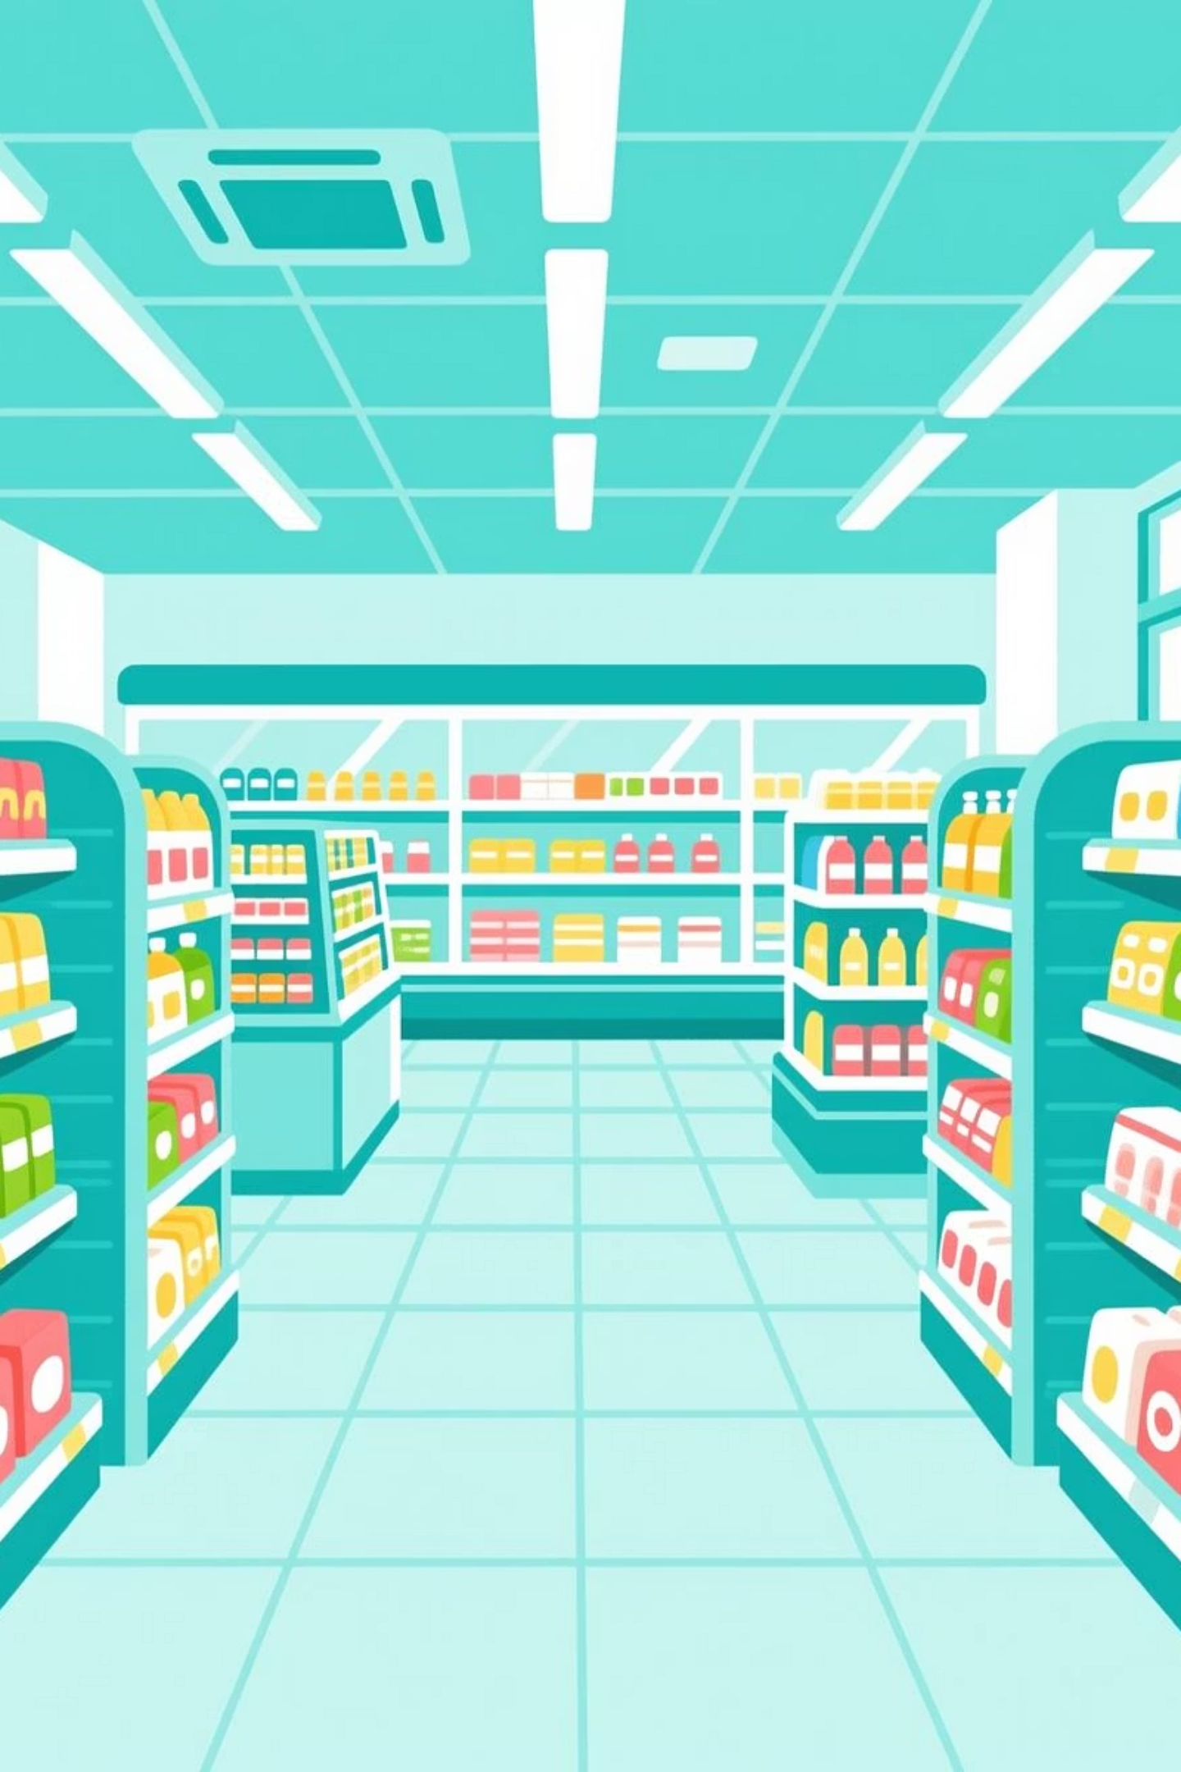
Recommendations
Prioritize High-Impact Promotions: Focus on BOGOF and Cashback; reduce reliance on low-performing percentage discounts.
Tailor by Location: Strengthen campaigns in Peshawar & Sialkot; test new strategies or boost efforts in Faisalabad & Hyderabad.
Optimize by Category: Use BOGOF & Cashback for Grocery & Staples; redesign promotions for weak products (e.g., bundle low-performing items).

